Slide 1
Array List
Rajasekaran S
Assistant Professor,
Department of Information Technology,
KGiSL Institute of Technology,
email: proffraja@gmail.com
Github:www.github.com/rajasekaranap

Slide 2
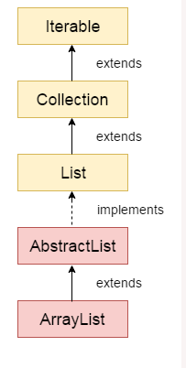
Array List
It is used as dynamic array and for sorting the elements.
It is part of java’s collection framework.
It comes from java.util packages.
It provides dynamic arrays in java
It inherits class called AbstractList and implements List interface.

Slide 3
Array List
It initialized with list size but it can grow and shrink.
It provides random access with elements.
Primitive Types not supported.
Wrapper class can be used instead of primirives.

Slide 4
Syntax
ArrayList<Type> object = new ArrayList<Type>();
ArrayList<String> aList= new ArrayList<String>();

Slide 5
Methods
void clear(): This method is used to remove all the elements from any list.
void add(int index, Object element): This method is used to insert a specific element at a specific position index in a list.
void trimToSize(): This method is used to trim the capacity of the instance of the ArrayList to the list’s current size.
int indexOf(Object O): The index the first occurrence of a specific element is either returned, or -1 in case the element is not in the list.
int lastIndexOf(Object O): The index the last occurrence of a specific element is either returned, or -1 in case the element is not in the list.

Slide 6
Methods
Object clone(): This method is used to return a shallow copy of an ArrayList.
Object[] toArray(): This method is used to return an array containing all of the elements in the list in correct order.
Object[] toArray(Object[] O): It is also used to return an array containing all of the elements in this list in the correct order same as the previous method.
boolean addAll(Collection C): This method is used to append all the elements from a specific collection to the end of the mentioned list, in such a order that the values are returned by the specified collection’s iterator.
boolean add(Object o): This method is used to append a specificd element to the end of a list.
boolean addAll(int index, Collection C): Used to insert all of the elements starting at the specified position from a specific collection into the mentioned list.

Slide 7
Thank You
Rajasekaran S
Assistant Professor,
Department of Information Technology,
KGiSL Institute of Technology,
email: proffraja@gmail.com
Github:www.github.com/rajasekaranap

